Slide 1
Bank Vault Management System
Course No: CSE 3118 Course Name: Microprocessor & Microcontrollers Lab
Course Teachers
Prof. Dr. Md. Shamim Akhter &
Lomat Haider Chowdhury

Slide 2



Group: 05 Team Name: Team_Delulu Group Members
Manzar Nur Rahman Eftee Sharjil Shabab Khan Md. Shaleh Abu Mayeen
ID – 20210104105 ID – 20210104108 ID - 20210104123
2

Slide 3
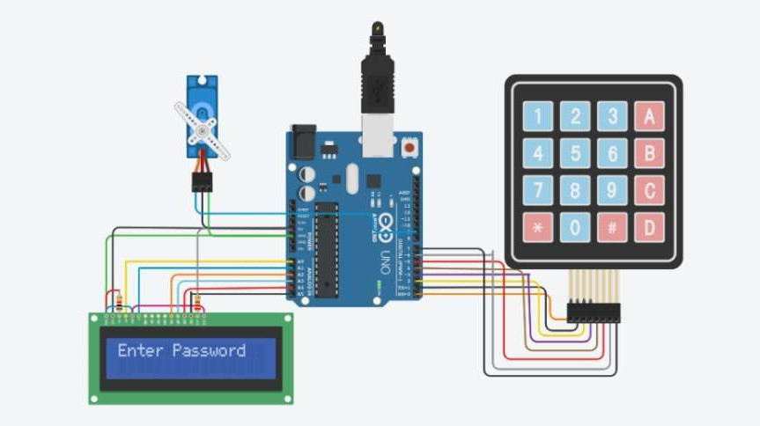
Core Concept
3

Slide 4
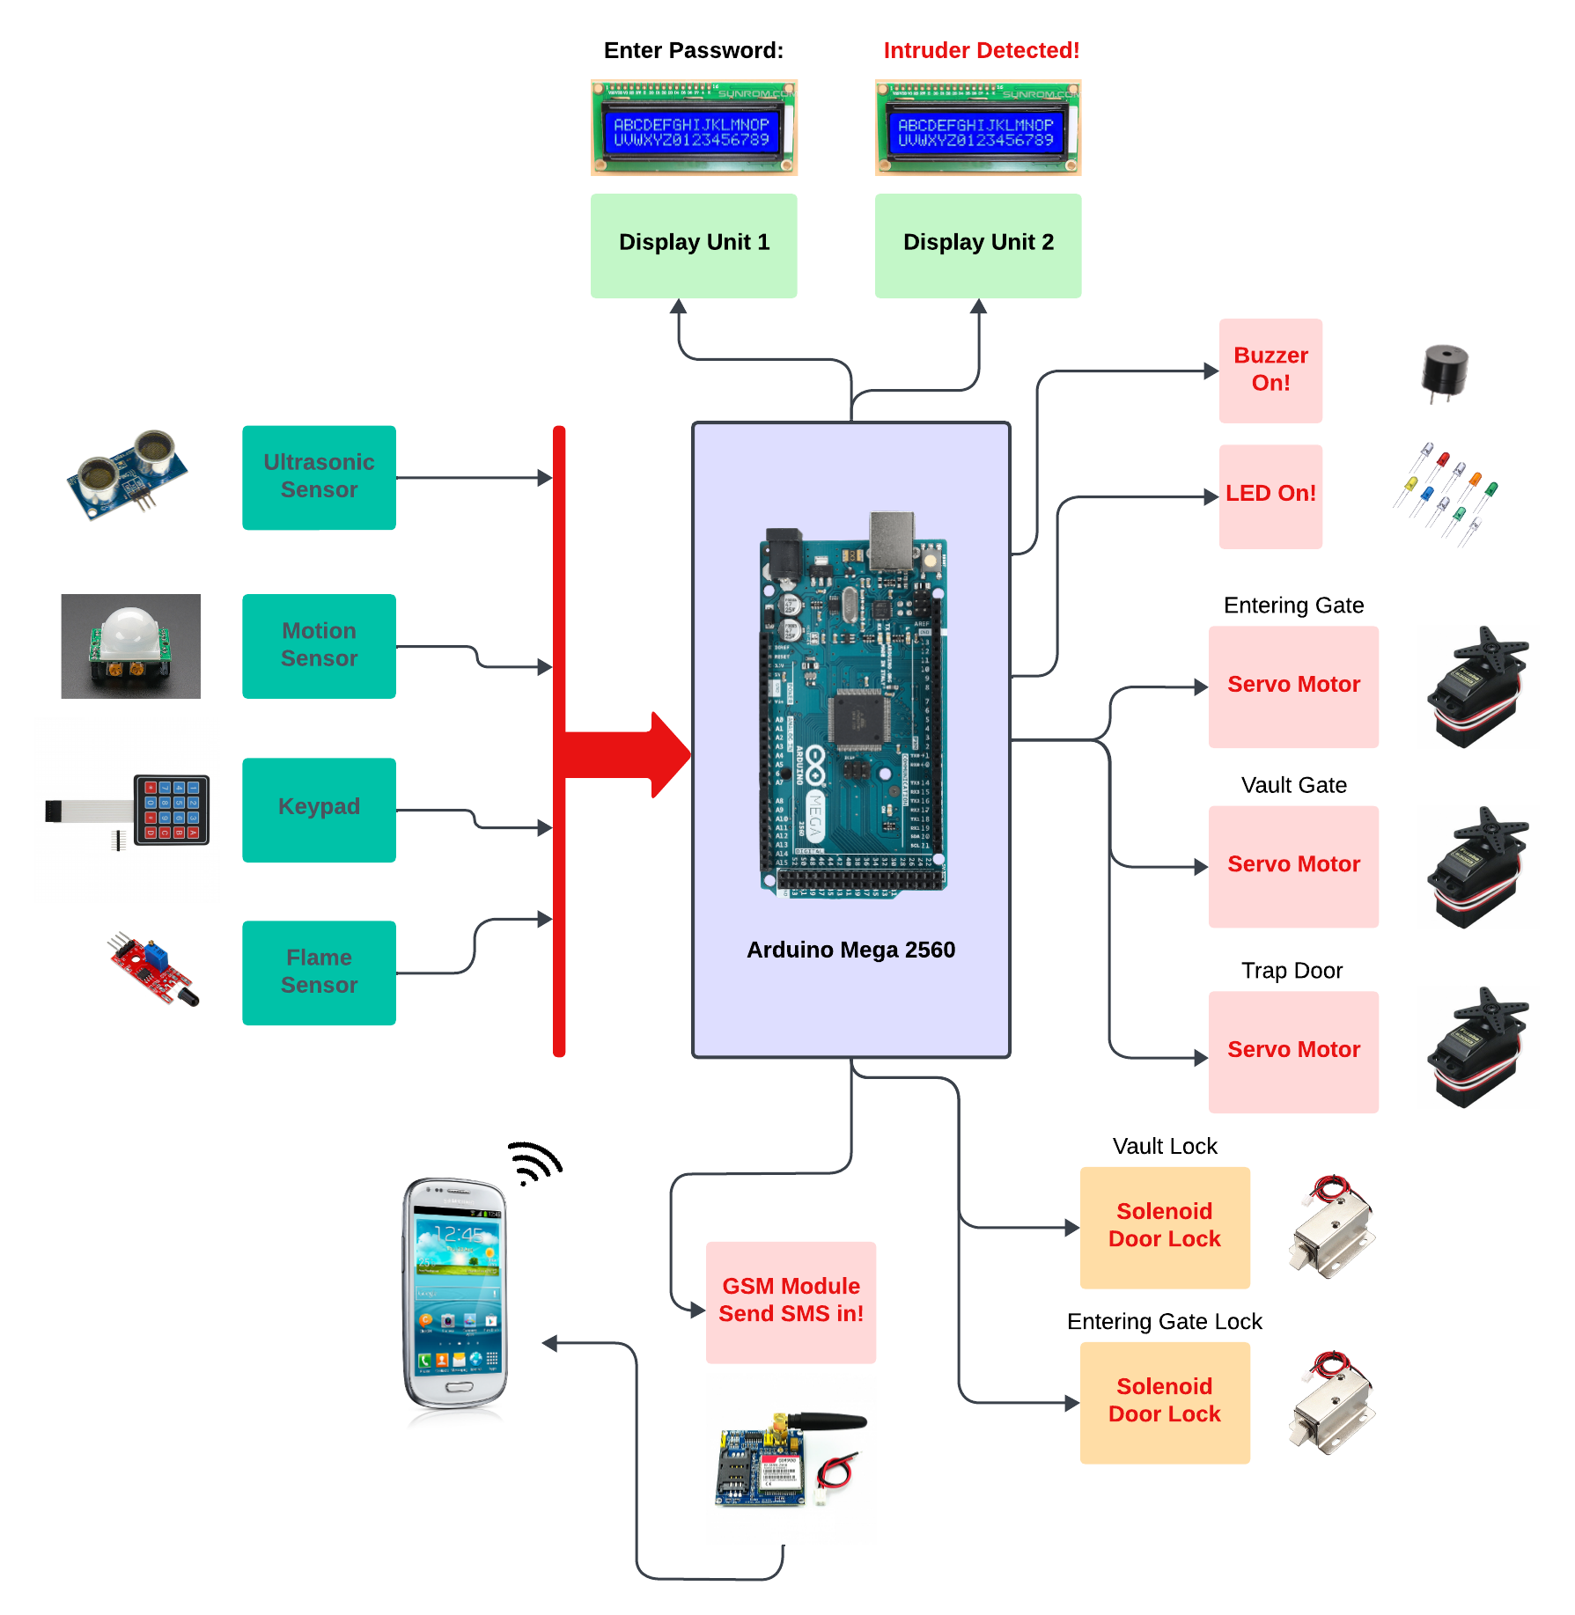
Visualization of our Project
4

Slide 5
Usage of Design tools, hardware and software
Design Tools: Proteus
Hardware: Arduino Mega, Buzzer, Servo Motor, Keypad, LED, register, Ultrasonic Sensor, GSM Module, Display, Lock
Software: Arduino IDE
5

Slide 6
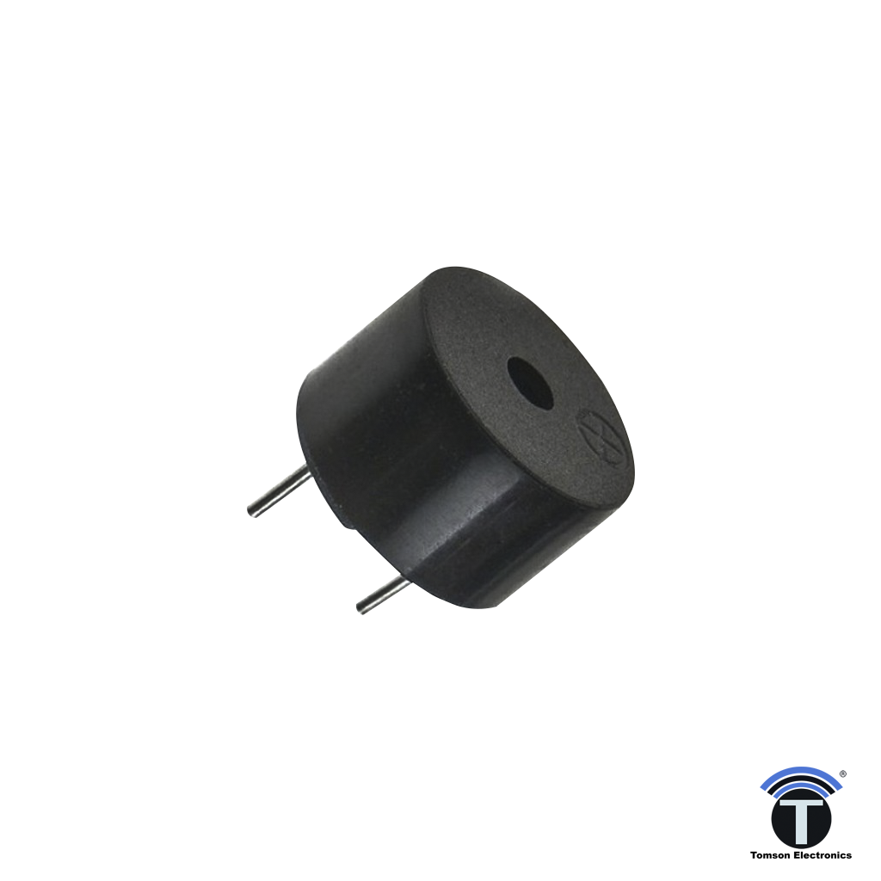
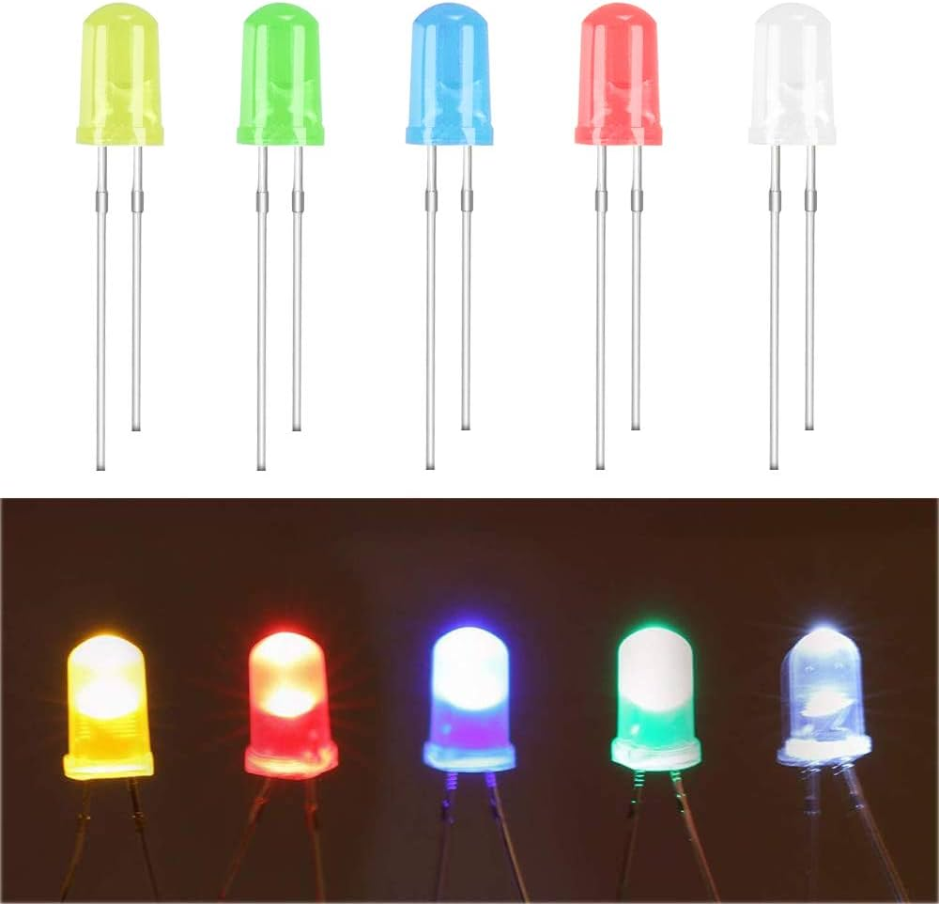
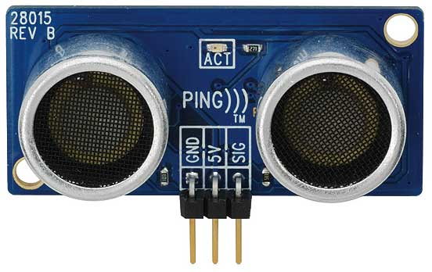
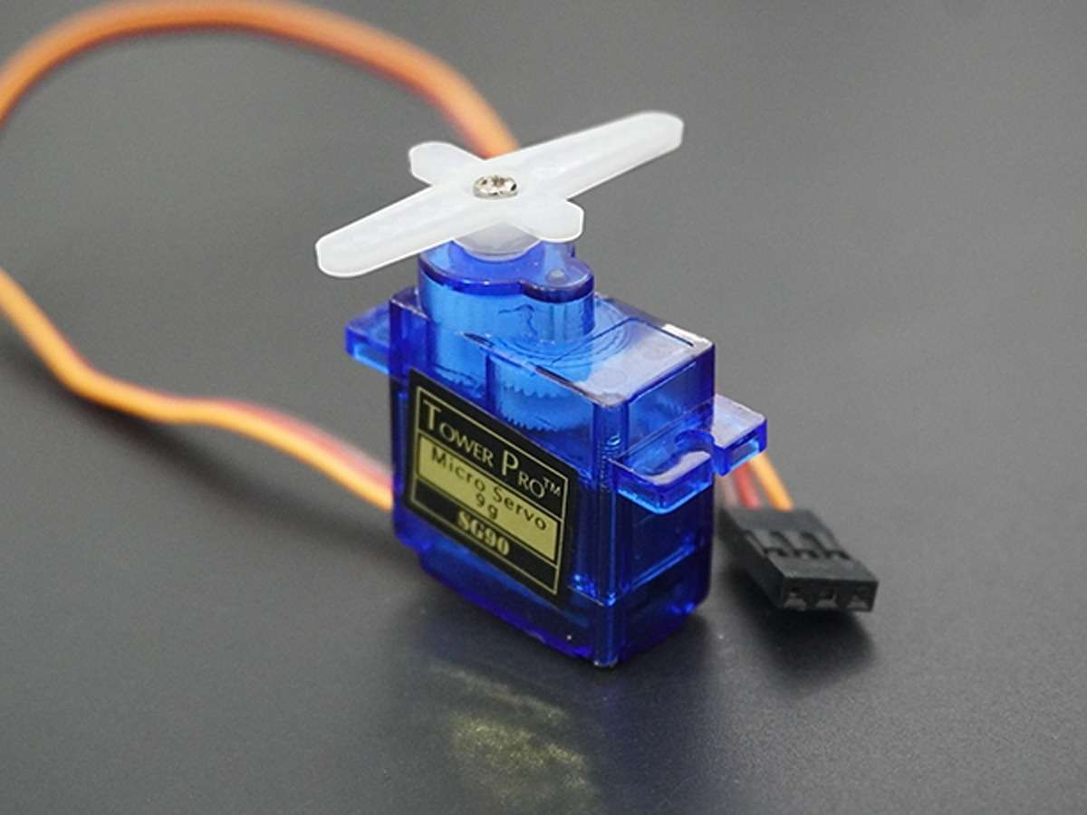
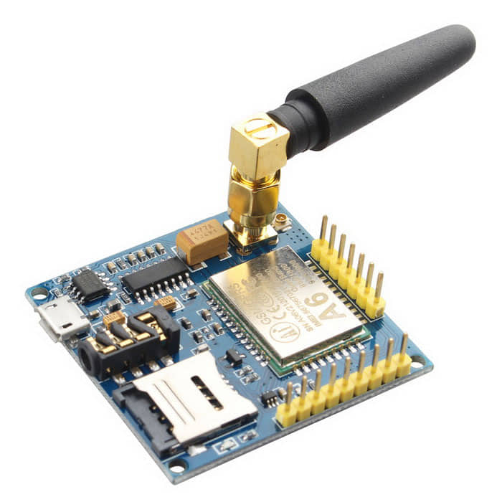
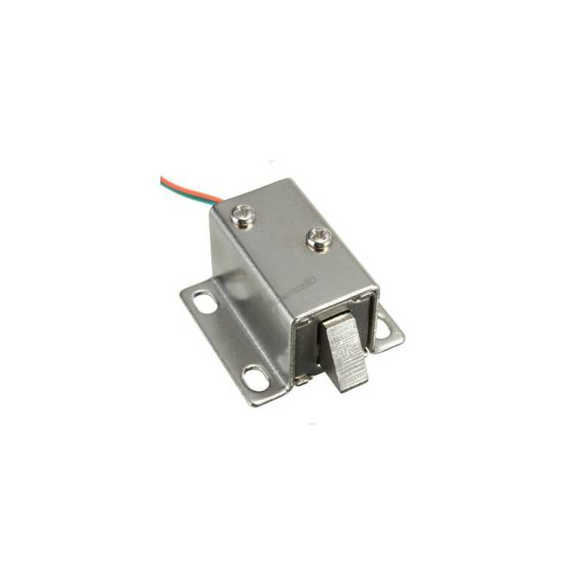
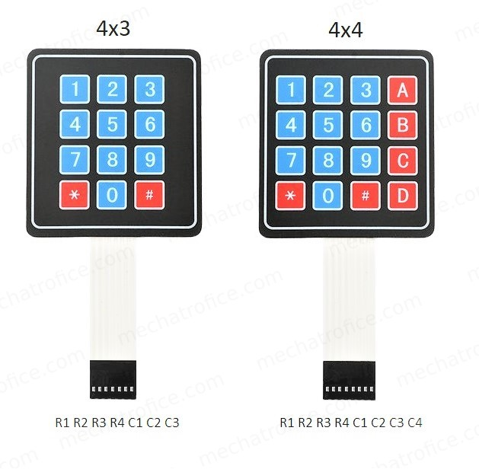
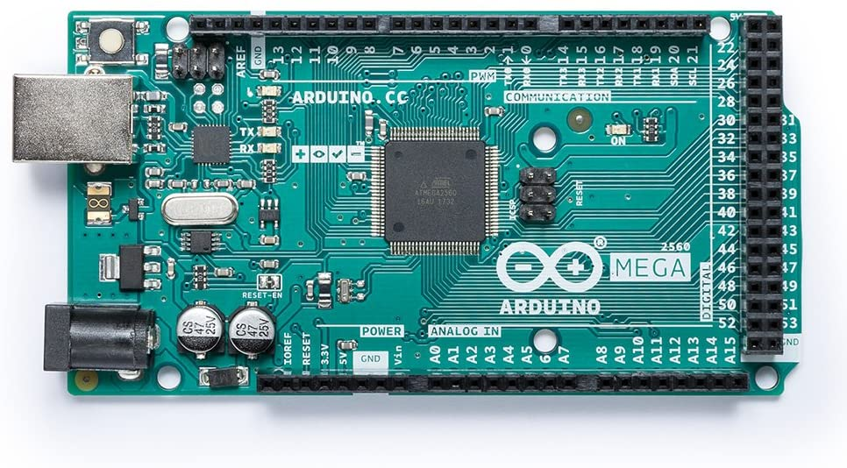
Sensor & Modules
LED
Buzzer
Ultrasonic Sensor
Servo Motor
GSM Module
Solenoid Door Lock
Keypad
Arduino Mega
6

Slide 7
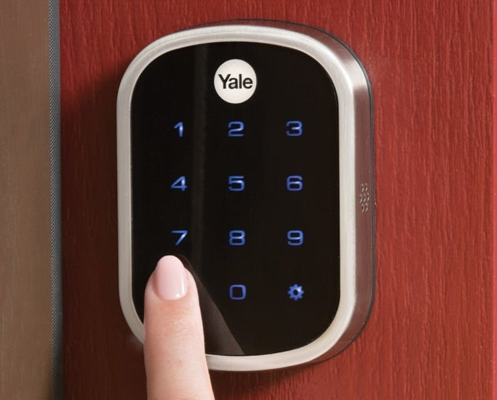

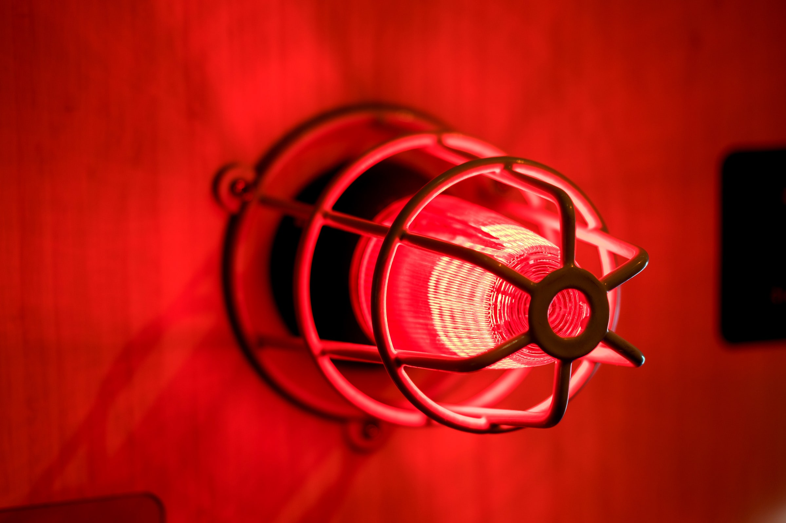
Working System
Keypad Unlocking System
Trap Door
System
Alarm & Messaging
System
7

Slide 8
Social Impact:
Impact on Social & Economic Development
Enhanced Security
Crime Deterrent
Trust & Confidence
Employment Opportunities
Customer Convenience
Technological Advancement
Emergency Preparedness
One step closer to being Digital Bangladesh!
8

Slide 9
Economic Development:
Impact on Social & Economic Development
Increased Productivity
Increased Investments
Job Creation
Increased Trust in Banking
Revenue Generation
Infrastructure Development
Tech Sector Growth
Internation Competitiveness
9

Slide 10
Economic Development:
Impact on Social & Economic Development
Increased Productivity
Increased Investments
Job Creation
Increased Trust in Banking
Revenue Generation
Infrastructure Development
Tech Sector Growth
Internation Competitiveness
9

Slide 11
Environmental Impact:
Optimize the Bank Vault System for minimal energy consumption during operation.
Implement strategies for responsible disposal and recycling of electronic components to minimize e-waste
Prioritize the use of environmentally friendly materials in the manufacturing process.
Conduct a thorough life cycle assessment to identify and address environmental impacts across the project's life cycle.
Design components to be easily recyclable or reusable to reduce landfill contributions.
Pursue and adhere to recognized environmental certifications to validate the project's commitment to sustainability.
9

Slide 12
Safety Norms
Follow IEC 60950 for voltage limits and protection.
Ensure efficient heat dissipation and temperature monitoring.
Minimize electromagnetic interference; adhere to EMC standards.
Comply with ISO 26262 or IEC 61508; integrate error detection and fail-safe mechanisms.
Enforce robust coding, testing, and security measures.
Maintain concise records of safety requirements and specifications.
Provide clear instructions for safe operation and maintenance.
9

Slide 13
Multidisciplinary Contribution:
Bank vault management system involves various stakeholders due to its diverse nature.
• Technical Experts
• Security Professionals
• UX Designer
• Financial Experts
• Maintenance and Support Teams
9

Slide 14
Estimated Budget
Equipment | Quantity | Budget (TK)
Arduino Mega 2650 | 1 | 1200
Servo Motor | 4 | 700
Active Piezo-Buzzer Module | 3 | 150
Flame IR sensor | 1 | 90
12 Volt Battery | 1 | 400
Infrared (IR) sensor | 1 | 90
GSM Module | 1 | 900
Ultra-Sonic Sensor | 1 | 130
Keypad | 1 | 75
Solenoid Door Lock | 1 | 750
Display | 2 | 400
LED | 10 | 20
Resistance | 10 | 10
Wire | As required | 200
Bread Board | 1 | 150
Card Board | 1 | 400
Total |  | 5665 TK
10

Slide 15
Thank you!
Do you have any questions?
11

